Slide 1
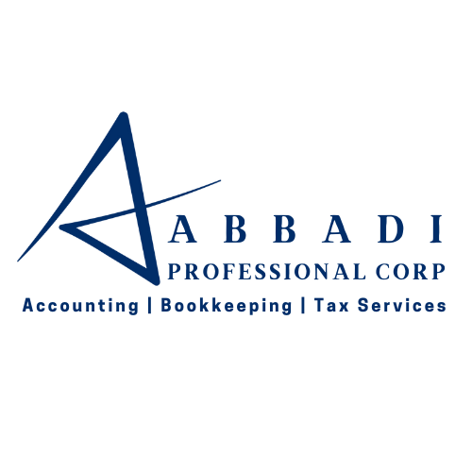






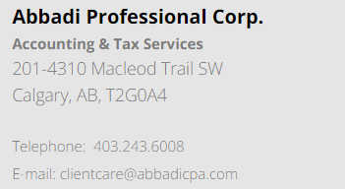

Professional Services:
Bookkeeping Services
Corporate Tax Preparation
Compilation Engagement
Review Engagement
Financial Audit Engagement
Business Consulting
Welcome to Abbadi Professional Corp!
We’re a team of skilled accountants, proficient bookkeepers, and experienced financial professionals ready to support you and your business with all your accounting requirements. Whether it’s Accounting, Bookkeeping, Tax Services, or business consulting, we’re here to help you achieve your goals.
Exclusive Offer for Seeker Members
Min. 10% savings (up to a maximum of 15%) off the price paid last year by the client

